Slide 1

CHAINREACTION GAME STRATEGY
CHEEKIBREEKI AI
BY JORDAN MARSHALL (18256716) AND JAKUB PAZEJ (18260179)

Slide 2
OBJECTIVES
To create a game strategy using modelling.
To successfully create a game strategy to compete against a player.
To use jABC4 to create an SLG.
To create our strategy by using SIBS for the SLG.

Slide 3
PRIME AREAS FOR ATOM PLACEMENT
Corner: The corner cells have a high bonus cell value as it only takes two atoms for it to explode. Therefore the cell is critical when there is only one atom in it.
Edges: The edge cells have a medium cell value as it only takes three atoms for it to explode. Therefore the cell is critical when there is only two or three atoms in it.

Slide 4
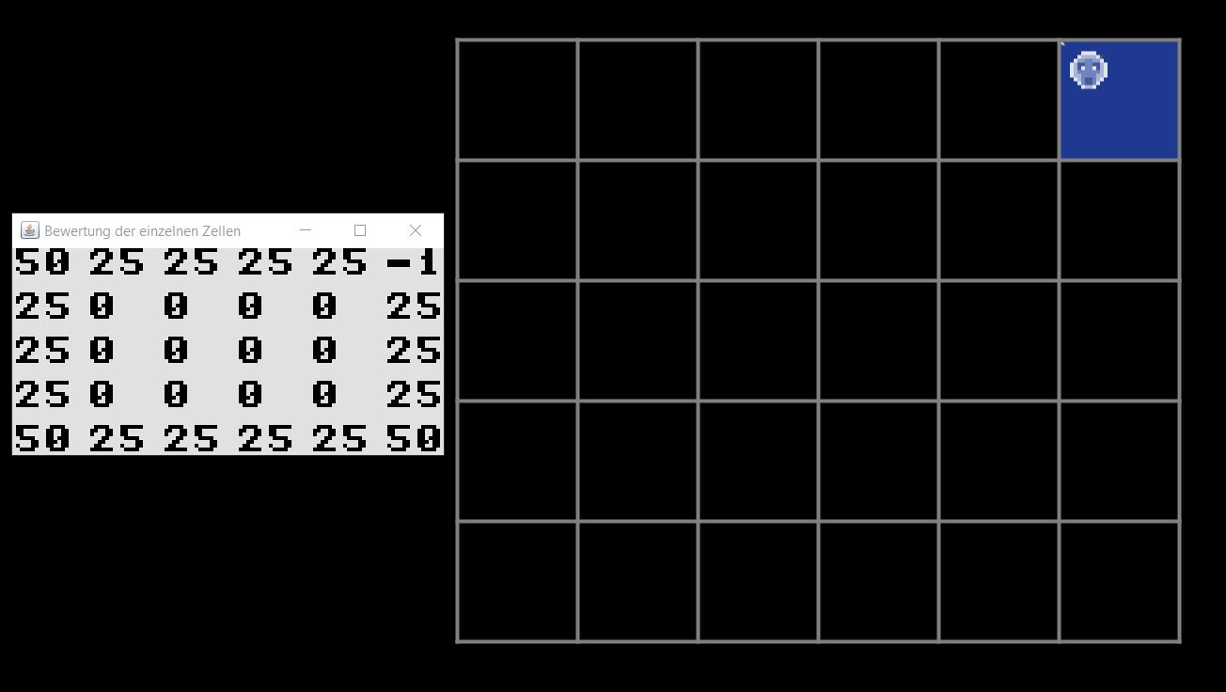
START OF THE GAME STRATEGY
At the start of the game the AI should take possession of the corner cells as they have a high cell value and are critical with only one atom in it.
It is important for the AI to keep the corners as when the other player progresses towards it, the AI can explode and capture the surrounding cells.

Slide 5
PROGRESSION THROUGH THE GAME STRATEGY
The corner cell is the most valuable cell. If the AI has possession it will try to keep it.
The model checks for many condition, such as “is it able to place a cell?”, “is it critical?” and the location of the cell.
If the cell is critical and is endangered, it has the highest cell value.
The addBonusX allows us to change the amount of bonus that is given to the cell. “X” is a variable.

Slide 6
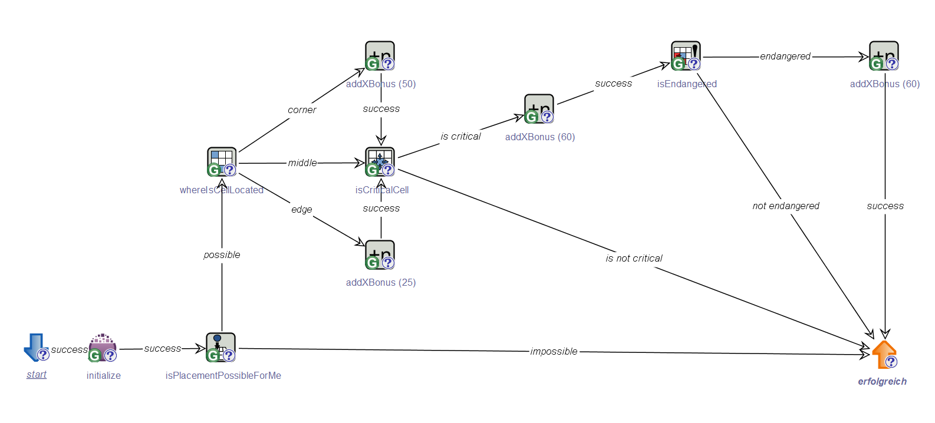
THE CHEEKIBREEKI AI GAME STRATEGY

Slide 7
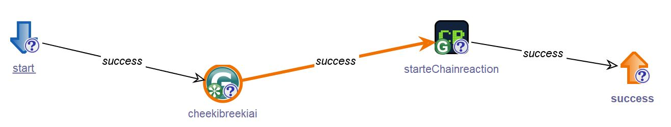
TESTING THE GAME STRATEGY
This model is needed to run the game strategy.
The model and game start up together in this model.

Slide 8

THE MOST IMPORTANT IDEAS…
To keep possession of the corners and the edges.
To control the amount of critical cells on the playing field to key areas. E.g: Corner and Edges.
To let opposition take control of most of the playing field and bait them into players critical cells.

Slide 9
WHAT WE ARE PROUD OF ACHIEVING…?
Learning to create a model with many conditions that can be run through a game.
Learning not to throw the PC at the wall when jABC4 doesn’t work.
Learning how to work with jABC4.
Learning about order of actions that affect the overall outcome of the programme.

Slide 10
THE END

